Slide 1

Top 3 Cryptocurrencies Analysis and Volatility prediction with hybrid LSTM-GARCH model
Zarmina Ursino
zarmina.ursino@studio.unibo.it

Slide 2

Objectives and Question
Objectives
Observe if Bitcoin, Ethereum and Ripple time series are satisfiable for the use of a hybrid model (RSME ≤ 0.8 is acceptable)
Implementing a rolling window approach to predict volatility by using the 3 models
Comparing the results of the 3 models and highlighting their significances
Research Question
Can a hybrid LSTM-GARCH model provide a substantial improvement in predicting the price volatility of Bitcoin, Ethereum and Ripple cryptocurrencies?

Slide 3


Workflow
Data Setting
Trends Plot (based on ‘Close’ prices)
Total traded
Candlesticks
Business Understanding
Data Exploration
Dropping NaN rows
Calculation of Volatility
Conclusion
Data
Data Cleaning
Prediction Models
Evaluation
GARCH
LSTM
GARCH+LSTM
- MSE Analysis
- RSME Analysis

Slide 4
Business Understanding
 | BITCOIN | ETHEREUM | RIPPLE
Algorithm | Proof-of-work SHA-256 | Proof-of-work Ethash | Consensus Ripple Protocol Consensus Algorithm
Mining | Yes | Yes | No
Maximum Supply | 21 billion | 18 million per year | 100 billion
Average Trans. Time | 10-minutes | Up to 14-seconds | 4 seconds
Market Capitalization | $952 billion | Almost $200.2 billion | Around $21.5 billion
Objective behind Protocol | To replace fiat currency in general marketplaces and give users full control of their money. | To make it easier for developers to create decentralized applications and to get rid of the security issues that come with using the internet. | To facilitate fast and cost-effective cross-border transactions.

Slide 5



Data Setting
09 November 2017 - 26 August 2021
1387 Records for each dataset

Slide 6
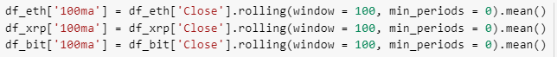
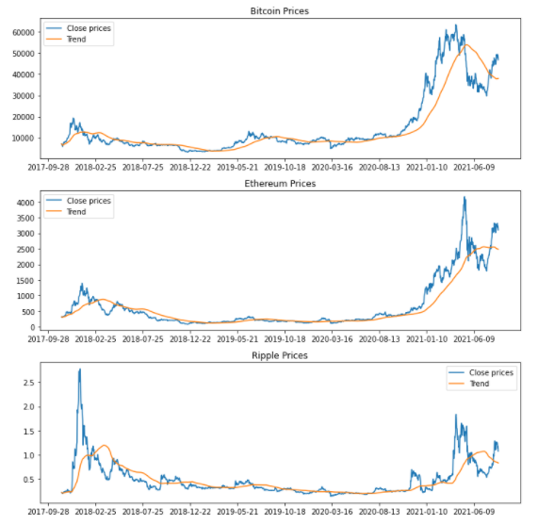
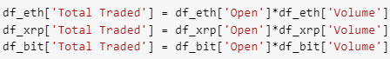
Data Exploration
First, I display the trends of the three cryptocurrencies by scrolling through a window of 100 samples and calculating each time the average price of 'Close’.
Then I calculate the 'Capital Market' by multiplying the Open price with the Volume.

Slide 7
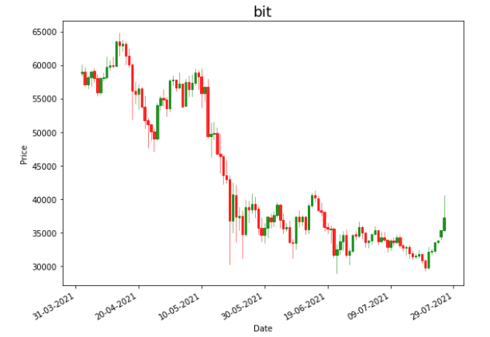
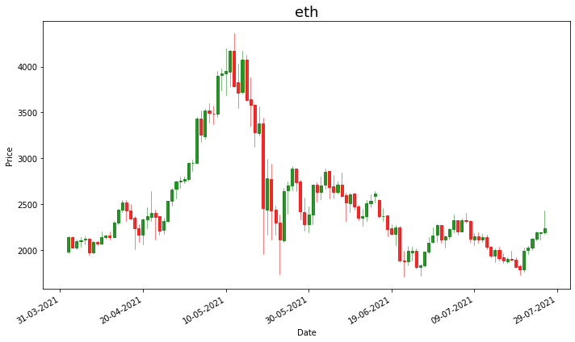
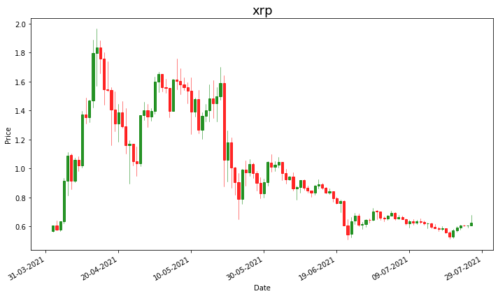
Data Exploration
Maximum of Total traded: 2 September 2020
Maximum of Total traded: 13 May 2021
Maximum of Total traded: 19 May 2021
1 April 2021 to 26 July 2021

Slide 8
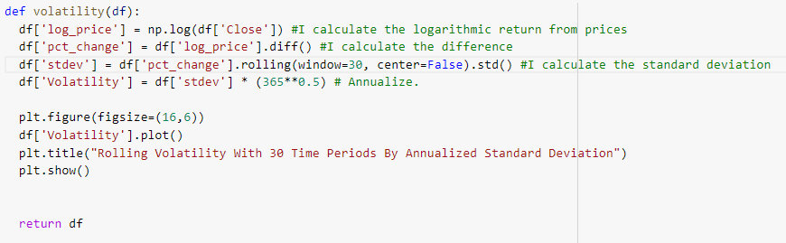

Volatility
Yang Zang estimator is used as it is independent of the jumps and the drifts in the time series and it’s also based on the assumption that the pricing is continuous .
Yang Zang Rolling Volatility with window size = 30 and period = 365
$$σ=\sqrt{\frac{1}{n}\sum_{i=1}^{n}{{\left(x_{i}−\overline{x}\right)}^{2}}}$$

Slide 9

GJR-GARCH Implementation
Generalized autoregressive conditional heteroskedasticity (GARCH) models are commonly employed in modeling financial time series that exhibit time-varying volatility.
In this research “Glosten-Jagannathan-Runkle GARCH” (GJR-GARCH(p,q)) model is built with values p=1 and q=1. Scaled volatility values are then passed through this model for fitting. To generate the rolling forecast volatility, alpha, beta, gamma and omega values obtained from the GJR-GARCH model fitting are required. These values are fetched from the summary of the fitting. Next step in implementation is to solve the GJR-GARCH for each available record and obtain its forecasted volatility based on its t-1 lag value. Thus, the model is denoted by the formula:
$$σ_{t}^{2}=w+αε_{t−1}^{2}+βσ_{t−1}^{2}+γε_{t−1}^{2}I_{t−1}$$
Where:
$$ε_{t}=σ_{t}z_{t}$$
$$I_{t−1}=O if ε_{t−1}≥0$$
And
$I_{t−1}=1$ if $ε_{t−1}<0$

Slide 10
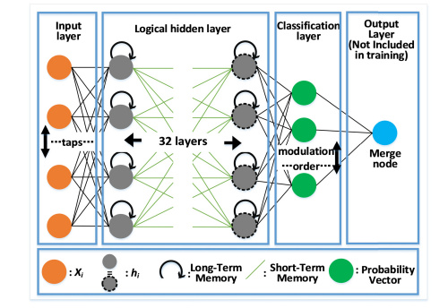
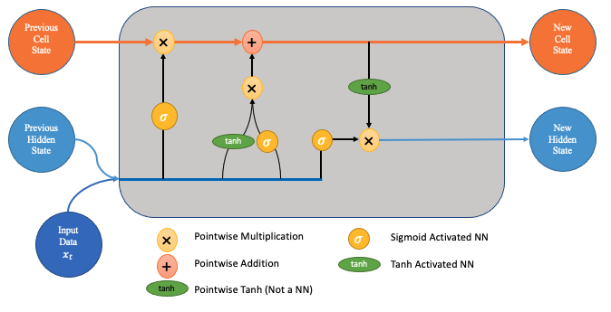
LSTM Implementation
Long short-term memory (LSTM) is an artificial recurrent neural network (RNN) architecture used in the field of deep learning. LSTM has feedback connections and it can process not only single data points, but also entire sequences of data. For example, LSTM is applicable to tasks such as unsegmented, connected handwriting recognition, speech recognition and anomaly detection.
In this research, features used are:
4 layers, 10 nodes per layer and 0.1 dropout for each layer to regularize.
5th layer was the output layer with 1 node
RNN regressor of TensorFlow is used for implementation with 20 epochs and 32 batch size.
This project is using ”Adam” optimizer thus optimizing ”mean squared error” as a loss function. Adam optimizer will change the weights of the nodes every iteration for the training dataset, making it much robust.

Slide 11
Hybrid Model Implementation
To reduce the error in the GJR-GARCH model forecasting, its forecasted volatility is fed to the LSTM model along with the normal volatility as a input. Hence the model have 2 input layers and 1 output layer while keeping rest of the parameters same. Addition on one more input node to the LSTM makes a model complexity higher.
Crypto prices
Garch (1, 1)
LSTM Architecture
Output

Slide 12
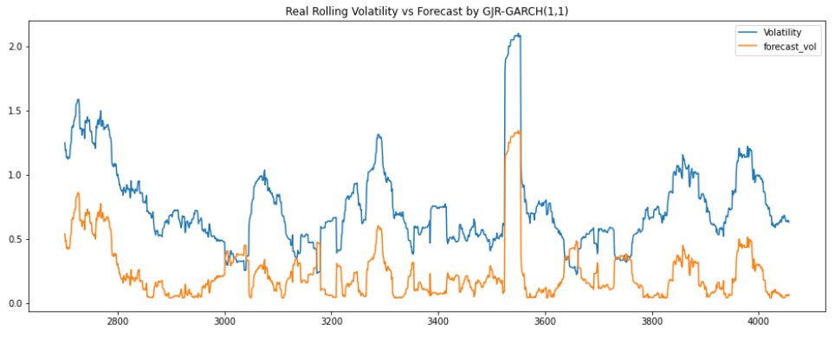
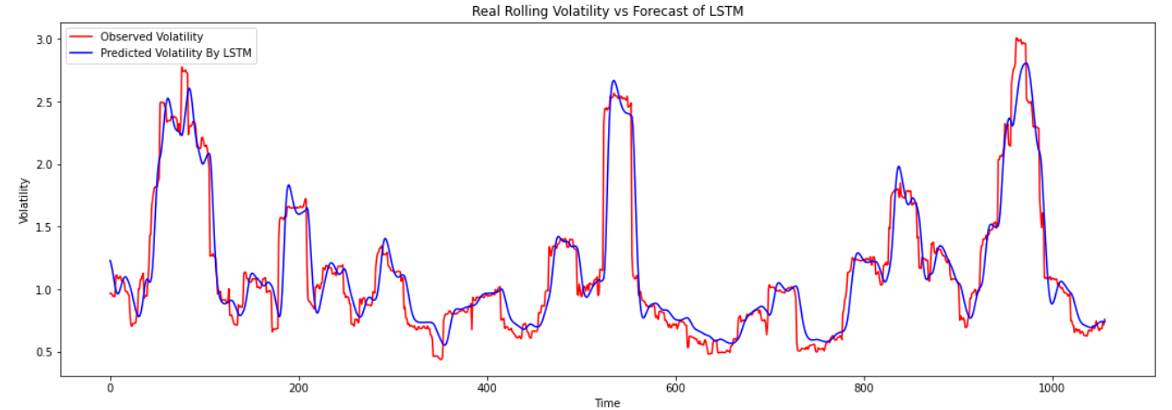
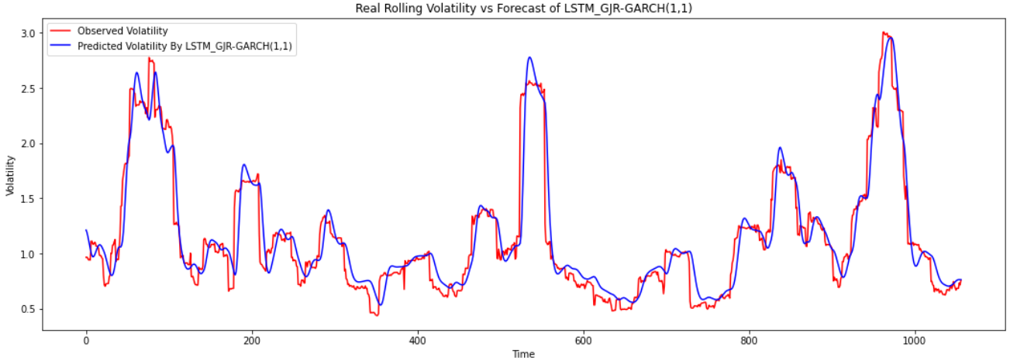
Bitcoin Results

Slide 13


Evaluation for Bitcoin
Epoch 1/20 34/34 [==============================] - 22s 426ms/step - loss: 0.7704
Epoch 2/20 34/34 [==============================] - 15s 431ms/step - loss: 0.2376
Epoch 3/20 34/34 [==============================] - 15s 430ms/step - loss: 0.1757
Epoch 4/20 34/34 [==============================] - 14s 423ms/step - loss: 0.1540
Epoch 5/20 34/34 [==============================] - 15s 428ms/step - loss: 0.1316
Epoch 6/20 34/34 [==============================] - 14s 423ms/step - loss: 0.1130
Epoch 7/20 34/34 [==============================] - 15s 429ms/step - loss: 0.0965
Epoch 8/20 34/34 [==============================] - 15s 429ms/step - loss: 0.0899
Epoch 9/20 34/34 [==============================] - 15s 427ms/step - loss: 0.0860
Epoch 10/20 34/34 [==============================] - 15s 431ms/step - loss: 0.0920
Epoch 11/20 34/34 [==============================] - 14s 422ms/step - loss: 0.0841
Epoch 12/20 34/34 [==============================] - 14s 421ms/step - loss: 0.0780
Epoch 13/20 34/34 [==============================] - 14s 425ms/step - loss: 0.0774
Epoch 14/20 34/34 [==============================] - 15s 435ms/step - loss: 0.0653
Epoch 15/20 34/34 [==============================] - 15s 426ms/step - loss: 0.0678
Epoch 16/20 34/34 [==============================] - 14s 426ms/step - loss: 0.0634
Epoch 17/20 34/34 [==============================] - 14s 423ms/step - loss: 0.0715
Epoch 18/20 34/34 [==============================] - 14s 423ms/step - loss: 0.0613
Epoch 19/20 34/34 [==============================] - 15s 427ms/step - loss: 0.0597
Epoch 20/20 34/34 [==============================] - 14s 414ms/step - loss: 0.0618
Model | RSME | Percentage change
GRR_GARCH(1, 1) | 0.5423051010434152 | --
LSTM | 0.7810342929066005 | ≈ +44,02%
GRJ-GARCH + LSTM | 0.7871026261560092 | ≈ -0.776%
$$RMSE=\sqrt{\frac{\sum_{t=1}^{T}{{\left({\hat{y}}_{t}−y_{t}\right)}^{2}}}{T}}$$
$$\%Change=(1−\frac{New RMSE}{Old RMSE} )×100$$

Slide 14
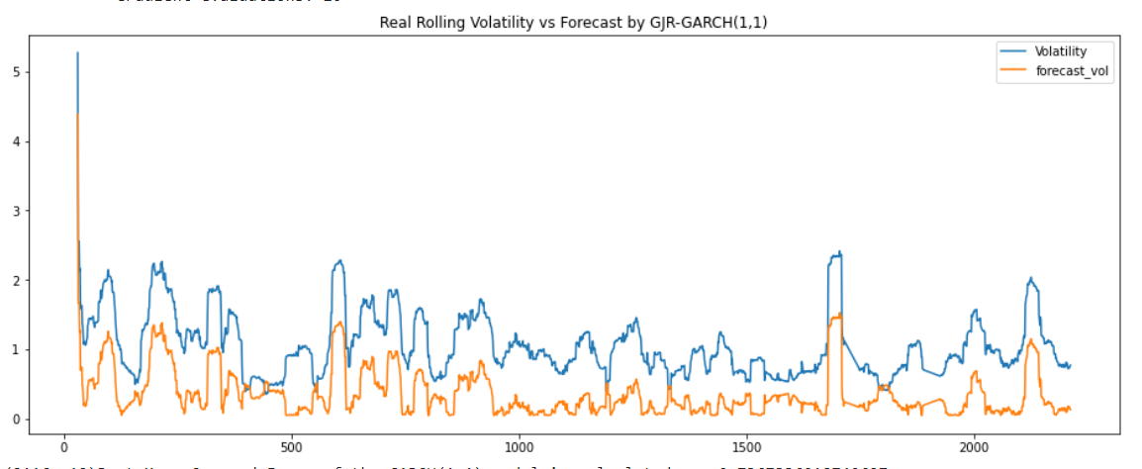
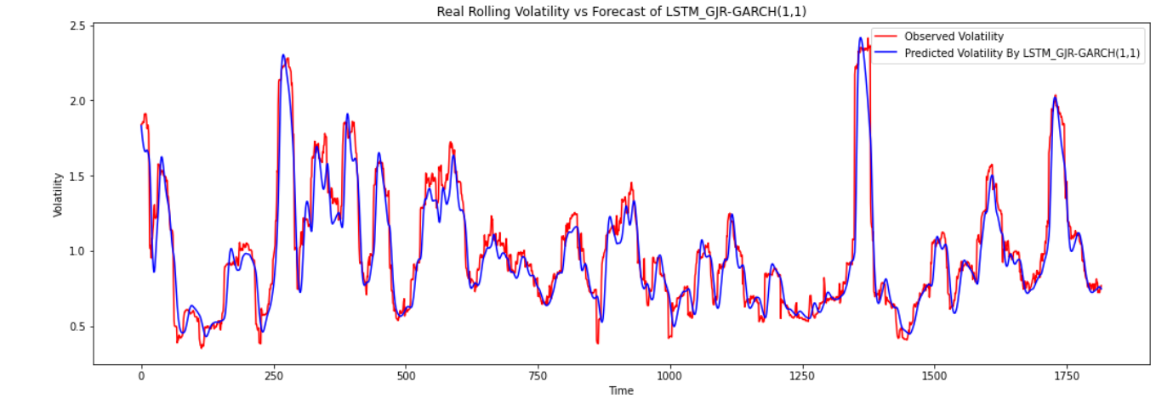
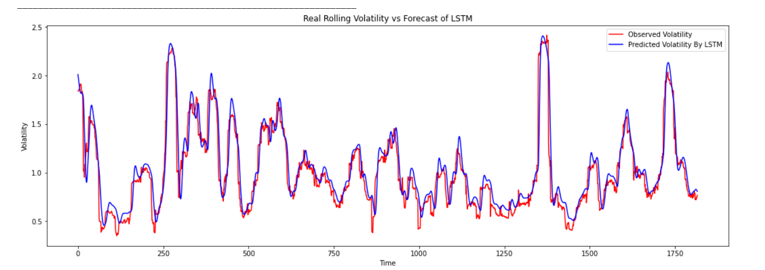
Ethereum Results

Slide 15
Evaluation for Ethereum
Epoch 1/20 31/31 [==============================] - 21s 432ms/step - loss: 0.5833
Epoch 2/20 31/31 [==============================] - 13s 435ms/step - loss: 0.1631
Epoch 3/20 31/31 [==============================] - 13s 430ms/step - loss: 0.1518
Epoch 4/20 31/31 [==============================] - 14s 441ms/step - loss: 0.1143
Epoch 5/20 31/31 [==============================] - 13s 436ms/step - loss: 0.0891
Epoch 6/20 31/31 [==============================] - 13s 434ms/step - loss: 0.0807
Epoch 7/20 31/31 [==============================] - 13s 430ms/step - loss: 0.0769
Epoch 8/20 31/31 [==============================] - 13s 424ms/step - loss: 0.0548
Epoch 9/20 31/31 [==============================] - 13s 427ms/step - loss: 0.0537
Epoch 10/20 31/31 [==============================] - 13s 430ms/step - loss: 0.0504
Epoch 11/20 31/31 [==============================] - 13s 418ms/step - loss: 0.0539
Epoch 12/20 31/31 [==============================] - 13s 424ms/step - loss: 0.0466
Epoch 13/20 31/31 [==============================] - 13s 425ms/step - loss: 0.0420
Epoch 14/20 31/31 [==============================] - 13s 422ms/step - loss: 0.0418
Epoch 15/20 31/31 [==============================] - 13s 426ms/step - loss: 0.0457
Epoch 16/20 31/31 [==============================] - 13s 423ms/step - loss: 0.0416
Epoch 17/20 31/31 [==============================] - 13s 428ms/step - loss: 0.0368
Epoch 18/20 31/31 [==============================] - 13s 428ms/step - loss: 0.0408
Epoch 19/20 31/31 [==============================] - 13s 429ms/step - loss: 0.0394
Epoch 20/20 31/31 [==============================] - 13s 431ms/step - loss: 0.0376
Model | RSME | Percentage change
GRR_GARCH(1, 1) | 0.6971294396705378 | --
LSTM | 0.542264490558765 | ≈ -22, 21%
GRJ-GARCH + LSTM | 0.5223026860375644 | ≈ -3, 68%

Slide 16
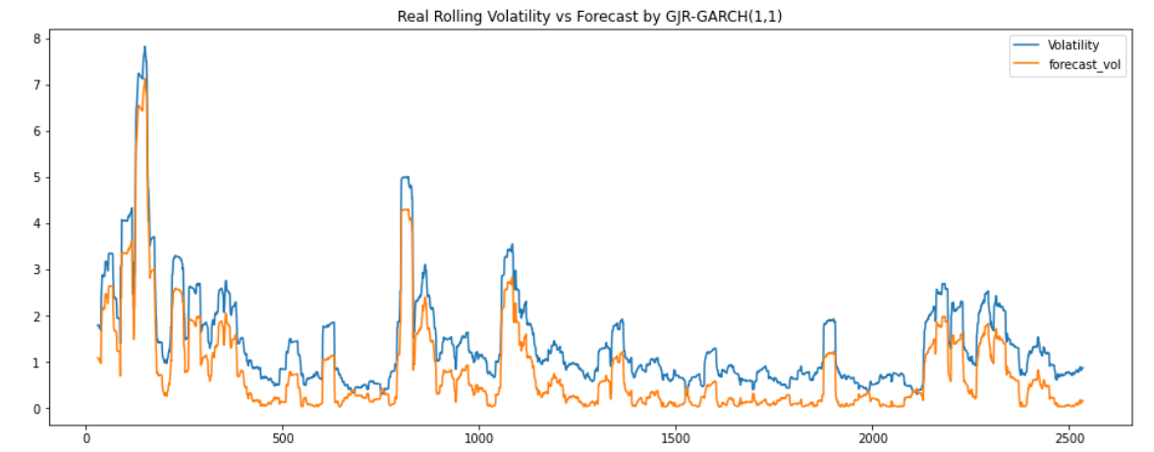
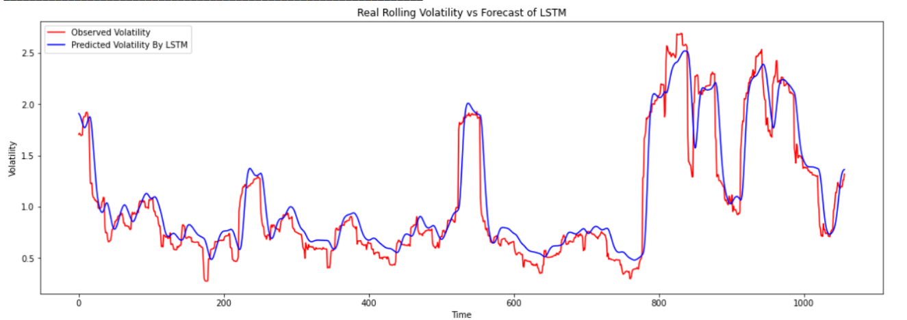
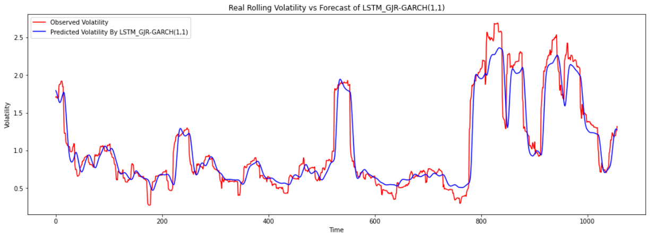
Ripple Results

Slide 17
Evaluation for Ripple
Epoch 1/20 34/34 [==============================] - 22s 423ms/step - loss: 0.6675
Epoch 2/20 34/34 [==============================] - 15s 427ms/step - loss: 0.2512
Epoch 3/20 34/34 [==============================] - 15s 429ms/step - loss: 0.1418
Epoch 4/20 34/34 [==============================] - 14s 419ms/step - loss: 0.1150
Epoch 5/20 34/34 [==============================] - 14s 420ms/step - loss: 0.1127
Epoch 6/20 34/34 [==============================] - 14s 421ms/step - loss: 0.1039
Epoch 7/20 34/34 [==============================] - 14s 424ms/step - loss: 0.0924
Epoch 8/20 34/34 [==============================] - 14s 424ms/step - loss: 0.0856
Epoch 9/20 34/34 [==============================] - 14s 422ms/step - loss: 0.0935
Epoch 10/20 34/34 [==============================] - 14s 425ms/step - loss: 0.0802
Epoch 11/20 34/34 [==============================] - 15s 427ms/step - loss: 0.0836
Epoch 12/20 34/34 [==============================] - 14s 420ms/step - loss: 0.0842
Epoch 13/20 34/34 [==============================] - 15s 427ms/step - loss: 0.0758
Epoch 14/20 34/34 [==============================] - 14s 420ms/step - loss: 0.0787
Epoch 15/20 34/34 [==============================] - 14s 426ms/step - loss: 0.0644
Epoch 16/20 34/34 [==============================] - 15s 428ms/step - loss: 0.0681
Epoch 17/20 34/34 [==============================] - 14s 421ms/step - loss: 0.0666
Epoch 18/20 34/34 [==============================] - 14s 422ms/step - loss: 0.0640
Epoch 19/20 34/34 [==============================] - 14s 425ms/step - loss: 0.0669
Epoch 20/20 34/34 [==============================] - 14s 422ms/step - loss: 0.0648
Model | RSME | Percentage change
GRR_GARCH(1, 1) | 0.6222032424652556 | --
LSTM | 0.8258696266553099 | ≈+32, 7%
GRJ-GARCH + LSTM | 0.8050234146532611 | ≈-2.52%

Slide 18

Conclusion
Objectives | Achieved or not?
Observe if Bitcoin, Ethereum and Ripple time series are satisfiable for the use of a hybrid model
Implementing a rolling window approach to predict volatility by using 3 models: GARCH, LSTM and GARCH+LSTM
Comparison of the 3 models results by highlighting their importance
The joining of the GARCH model and the LSTM model enhances the capability of non-stationarity features capturing and meanwhile increases the ability in modelling the nonlinearity in data.
This study reveals that the combination of parametric models like GARCH with deep neural network may produce better results in cryptocurrency price forecasting especially in the case of highly volatile data or when short data sequences are available. This research can be used also in other applications where high volatility and scarcity of data are the main characteristics

Slide 19
*Limitation
*The limitation of this research is, it only consists of the historical data, but it ignores external factors affecting the pricing and volatility such as news outbreak, change in governance, imposition of new rules, etc. This research can be revisited once there is adequate amount of data available for the training of heavy models like LSTM. It may really be interesting to see the results of sentiment analysis on such new and volatile asset class. For the time being, this research can be used as a base for developing new hybrid models and testing their volatility.

Slide 20
Thank you!

Slide 21
References
Datasets Source Link
“Blockchain 2021”, Nathan Real
Bitcoin, Ethereum and Ripple: the differences Link
How to read candlesticks? Link
Yang, D. and Zhang, Q. (2000). Drift-independent volatility estimation based on high, low, open, and close prices, The Journal of Business 73(3): 477–492 Link
MAE, MSE, RMSE, Coefficient of Determination, Adjusted R Squared — Which Metric is Better? Link
GARCH Modelling of Cryptocurrencies, Link
A hybrid Model integrating AAN and GARCH for BTC price prediction, 2021 Link

